Slide 1
UK Community Mental Health and Individual Placement and Support
Jan Hutchinson
Director of Programmes
Centre for Mental Health

Slide 2
Helping people with mental health needs to live independently
Community support
Individual Placement and Support (IPS) in the UK
How Centre for Mental Health supports IPS across the UK

Slide 3
UK community mental health support teams
Psychiatrist, Nurse
Social Worker
Psychologist, Psychotherapist
Occupational Therapist
Support worker: housing, daily living, education, volunteering, employment(?)
Employment Specialist

Slide 4
What do people say they need?
Somewhere to live
Someone to love
Something to do
Someone who helps

Slide 5
What is different about IPS?
No-one excluded
Rapid job placement
Minimal pre-work training
Personalised job search
Finding understanding employers
Long-term support in work
Individual Placement and Support

Slide 6
US 1996 First IPS trials produced surprising results
2x
Employment rates in first trial were twice as good as existing model
Challenged long-held beliefs that work is not good for some people
Led to conversion of old-style day services to IPS services
1x

Slide 7
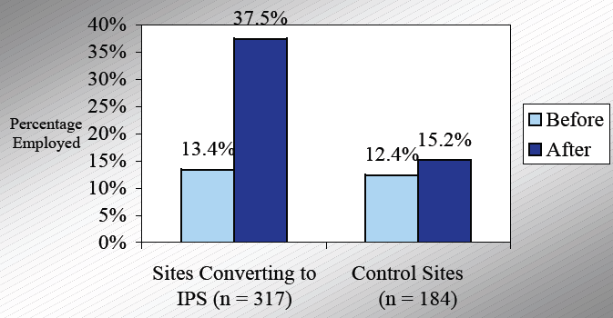
Converting traditional services to IPS: Employment rates

Slide 8
IPS is cheaper and more effective than a social enterprise
All the funding goes directly to the support!
€€€€
Overheads
Rent
Staff
Equipment
insurance
Trading losses

Slide 9
UK Centres of Excellence demonstrating IPS
Centre for Mental Health recognises the high quality of IPS services in:
Central & North West London
Coventry
Devon
Essex
Manchester
Nottingham
Shropshire
Somerset
Staffordshire
Stoke
South West London
Sussex
Worcestershire
Walsall

Slide 10
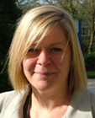
Add a Regional Trainer for better outcomes
The role of ‘Regional Trainer’
Working with the Employment Specialists and the Health staff
Information for clinicians
Training
Engaging with employers
Becky Priest

Slide 11
Paid work outcomes compared with monthly target April 2010-Nov 2011
Introduction of the Regional Trainer in November 2010
Reproduced with permission of Southdown Supported Employment

Slide 12
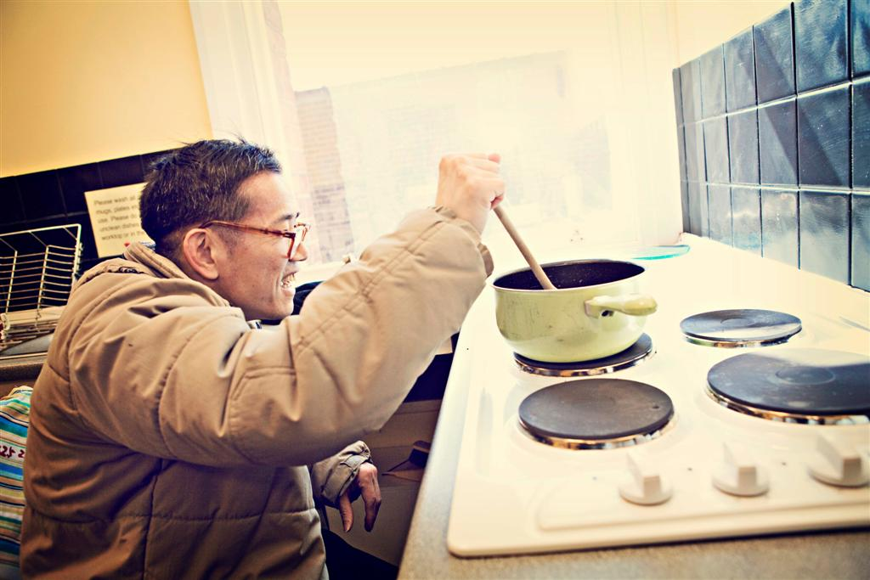
Supporting independent living
Focus on recovery
Suitable housing
Opportunity for relationships
The benefits of working:
Reduces symptoms
Increases support network
Provides an income
Increases self-worth
Personalised support

Slide 13
Thank you
Jan Hutchinson
Tel +44 (0)207 827 8397
jan.hutchinson@centreformentalhealth.org.uk
Twitter @Jan_CMH

