Slide 1
Lars Rickardt
lars.rickardt@s-activa.se

Slide 2
The Actíva Foundation
Founded 1989
Founders: Örebro County Council and Örebro Municipality
Commission: to find jobs for people with disabilities and health problems
Method: adapted and individual ”Supported Employment” called the Actíva Model®

Slide 3
Activa in Örebro county
Actíva is represented all over the county.
Located in:
Örebro, Lindesberg,
Karlskoga & Hallsberg

Slide 4
Three areas
Work
Education
Projects

Slide 5
Actíva staff
Board
Heads of Unit
Internal Services
Work Counsellors
Marketing Group
Preparatory Units
Projects
CEO
45 employees, including projects

Slide 6
Activa´s main mission
The overarching objective for Actíva is to support people with disabilities to get a job in the open labour market.
We think that everyone who wants to work, should get the opporturnity to do so, with the right support and adjustments.
It´s our belief that diversity is enriching and beneficial for every workplace.

Slide 7
Objectives besides finding jobs
Projects – develop methods
– reach new target groups
– change attitudes towards people with disabilities
Education for professionals
Cooperation with the local university in order to
increase knowledge of supported employment

Slide 8
Actíva Model®
The Actíva model is an individually designed, long-term support model for persons who, due to disabilities, find the labour market difficult to access.
The model is built upon three phases: to GAIN a job, to GET a job and to KEEP a job.

Slide 9
The Actíva Model
Assigning authority: social insurance office, local employment service or the municipality
The first contact
Three part meeting, where the applicant, the handling officer
from the authority and Activa´s work counsellor meet.
The applicant tells about demands and wishes and gets
information about the possibilities Activa can offer.
Three part meeting
Then follows a mapping process and
analysis of possible routes to reach the labour
market. The applicant and Activa´s work
counsellor learn to know each other.
Mapping process
Regular meetings with the applicant. Analysis of the applicant´s ability compared to demands on the labour market. Need of technical aid, education and information to collegues about a certain disability, coordinating of resources? Support that is necessary to get an employment.
Together with the applicant, the Activa work counsellor makes an action plan.
A deeper analysis
Two alternatives:
1. Training in Activa´s own preparatory units or in other placements where Activa can supervise the work.
2. Go directly towards the open labour market and a placement in order to get a ”real employment”.
Action plan
Preparatory units
Placement in the open
Labour market
During the transferring phase, Activa strives to increase the professional role of the applicant and gradually minimise the dependence of the support from Activa.
SUPPORT
Transferring phase
Education
Employment
Occupation

Slide 10
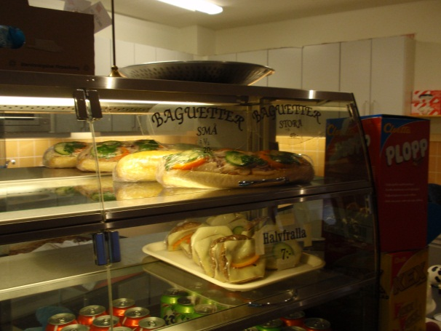
Actívas Preparatory Units
Work training under supervision of tutors.
Routines, tasks, instructions, cooperation, strenghts/weaknesses etc.
Feedback to the Work counsellor
Café
Lunch room & Conference service
Cleaning/reparing technical aids
Laundry

Slide 11
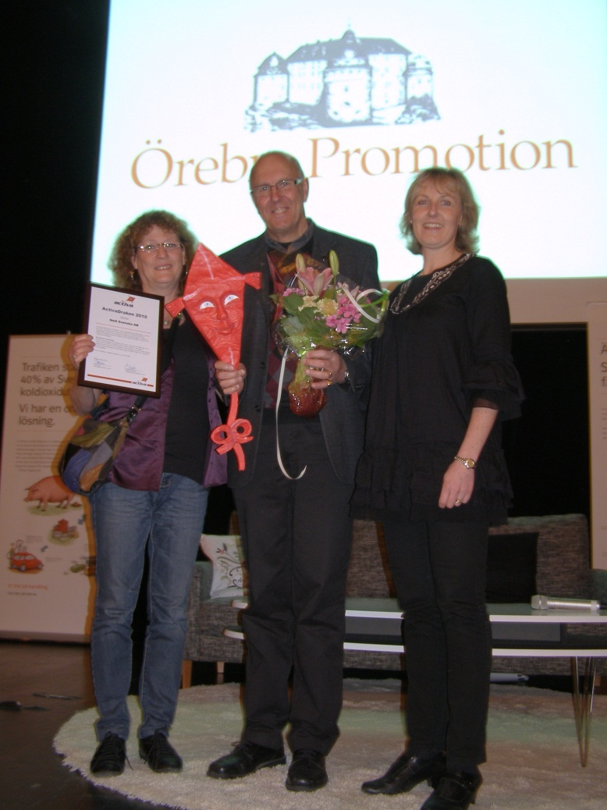
The Activa Kite Award
By awarding the Actíva Kite every year, to a workplace in each county, we want to give credit to employers/ workplaces which during the year have shown committment by accepting one of our applicants into their business. The employer should be a role model for others when it comes to care, social responsibility and receiving an applicant.

Slide 13
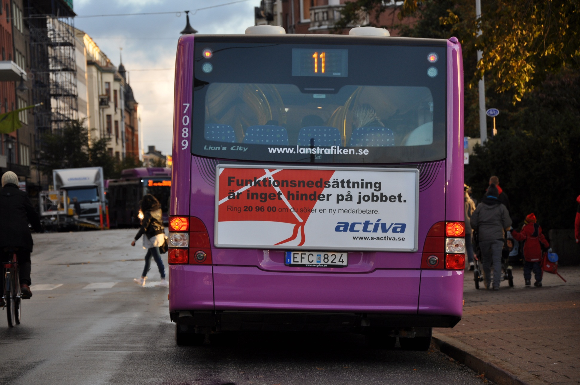

Slide 14
Transit Project
Financed by the European Union, 1 June 2010 - 31 Dec 2013
Objective: to create a transitional model from school finish/graduation, towards the labour market
Ensure a smooth transition from school into the labour market, or further education
Help the participants to prepare themselves for adult life

Slide 15
Partnership
Actíva
4 municipalities
Upper Secondary School (High School)
Day Center for people with Disabilities
Social Welfare Services
The Employment Service
The Social Insurance Office

Slide 16
Target group
18-29 years
Different types of disabilities, mainly learning disabilities, ADHD, Asperger syndrome.
Method
Supported Employment
The Actíva Model
Early intervention

Slide 17
During the last year in school
Assign an individual work counsellor
Personal background mapping with help from the work counsellor
Job matching
On the job training, work practice, individual support
Group activities, specific information/knowledge about the labour market
Coordinated service and common focus from The Employment Service, The Social Insurance Office, School etc.
An Individual Action Plan, to ensure that young people take personal responsibility and participate in decisions about their own future

Slide 18
OCN - Open College Network
A tool to recognise and communicate life long, non-formal learning outside the formal school system.
Vehicle maintenance, café, building and property maintenance, information/knowledge regarding the labour market.

Slide 19
Social Enterprises
Encourage the Social Non Profit Sector, enterprises which aim to employ young people with disabilities
Mobility
Work practice abroad for 4 weeks
Pistoia, Italy and Landshut, Germany
Equal Opportunities
Accessibility

Slide 20
Staff Project Transit
4 Work Counsellors
4 Specialised Tutors
1 Special Needs Teacher
1 Accounting Clerk
1 Marketer
1 Project Manager

Slide 21
Current status
78 active participants
24 participants have succeeded in finding employment
16 participants have gone on to higher education

Slide 22
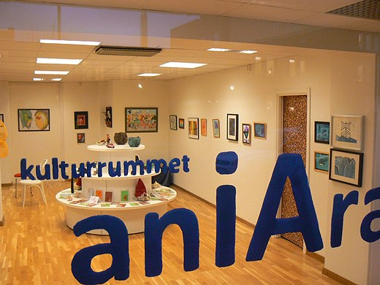
A social enterprise with 30 active participants
Culture
Maintenance (Includes both building and property maintenance and vehicle maintenance)

Slide 23
Mobility – work practice abroad
So far:
41 persons
4 weeks
Tuscany, Italy
7 persons, 4 weeks Landshut Germany
Programmes: ESF and Leonardo
Workplaces: plant nursery, park maintenace, restaurant, café, kitchen, property maintenance, culture house

Slide 24
Three phases
Preparations
Employment/work life related activities
The journey, flight, expectations, meeting a new culture, language, safety, responsibility, preference of workplace
Realization, with two accompanying tutors the first week
Work practice, cope accomodation and spare time, documentation
Evaluation
Summary - report and CV
What´s next? Work, studies?

Slide 25
Host organisation
Accomodation
Introduction week
Work placements
Evaluating meetings
Support/tutoring/monitoring

Slide 26
Target group & Objectives
18-29 years
Different types of disabilities, mainly learning disabilities, ADHD, Asperger syndrome
Better self-esteem
Personal growth and development
More independent
Work experience
Closer to the labour market

Slide 27
www.s-activa.se

